Slide 1
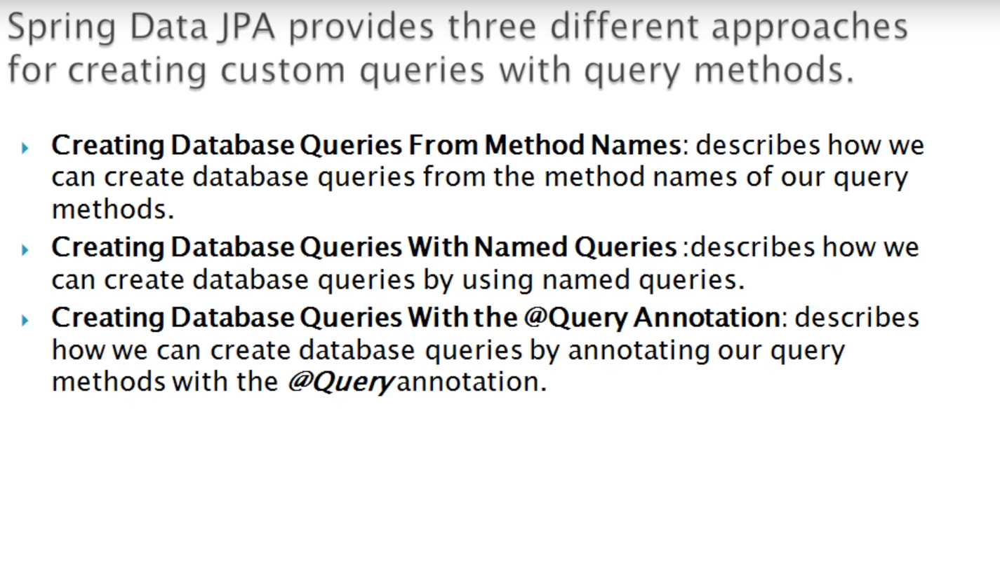
Spring JPA – Data Retrieval

Slide 2
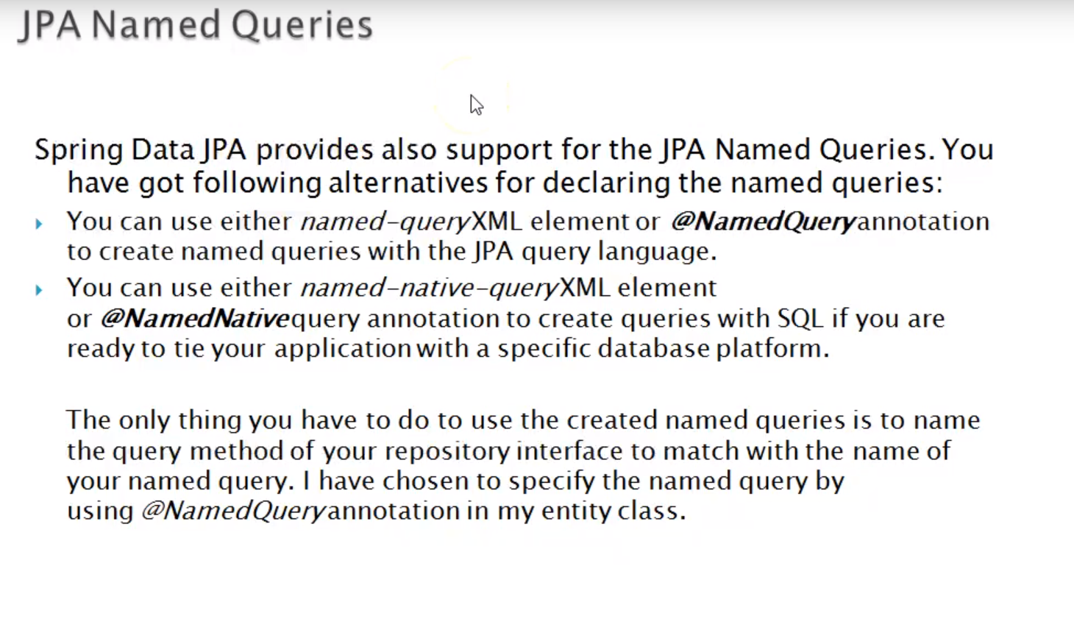
Spring JPA – Data Retrieval

Slide 3
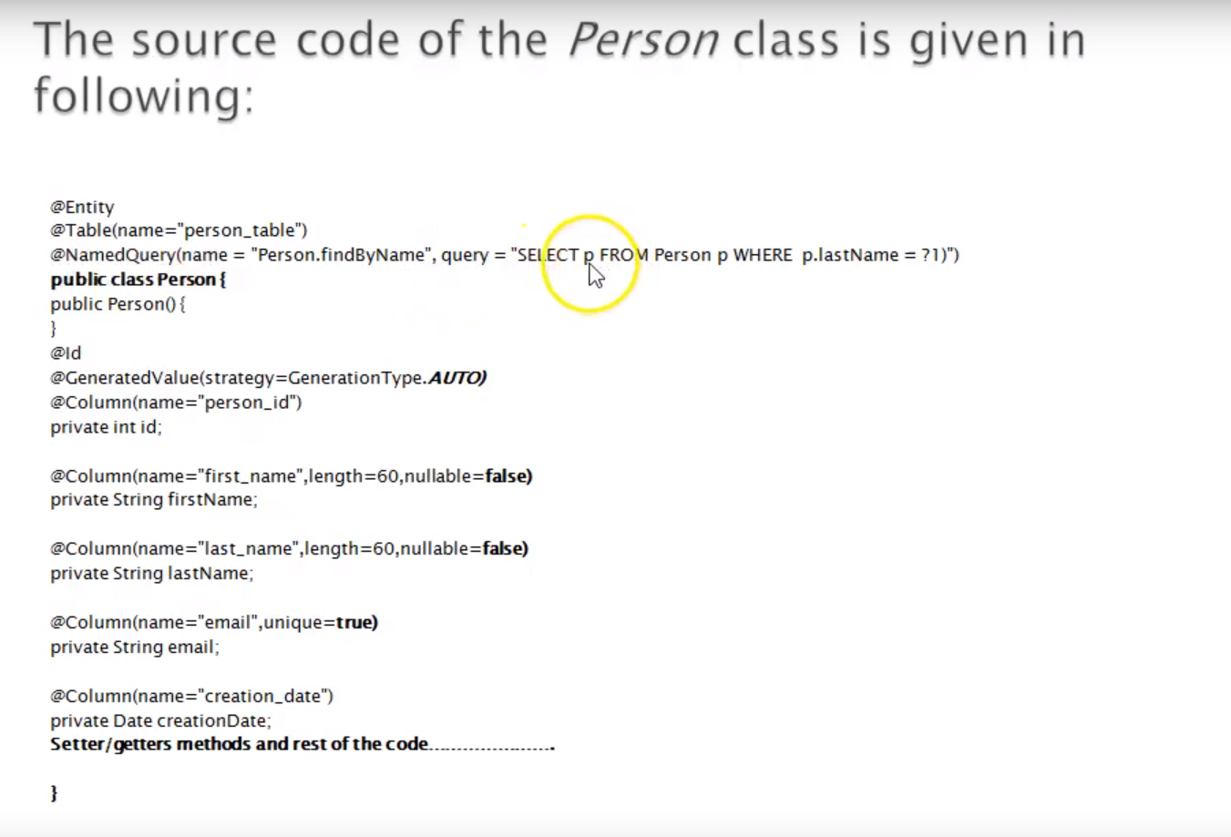
Spring JPA – Data Retrieval

Slide 4
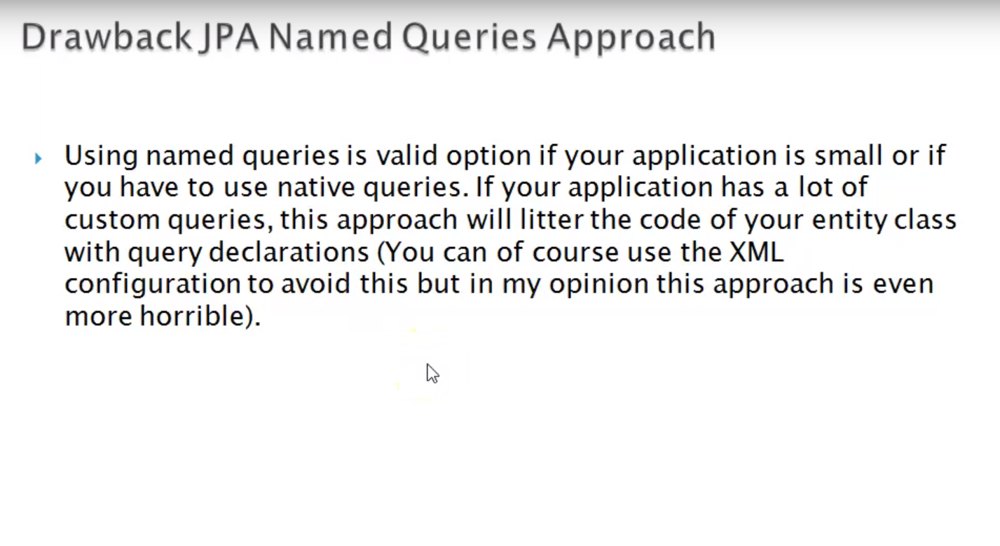
Spring JPA – Data Retrieval

Slide 5
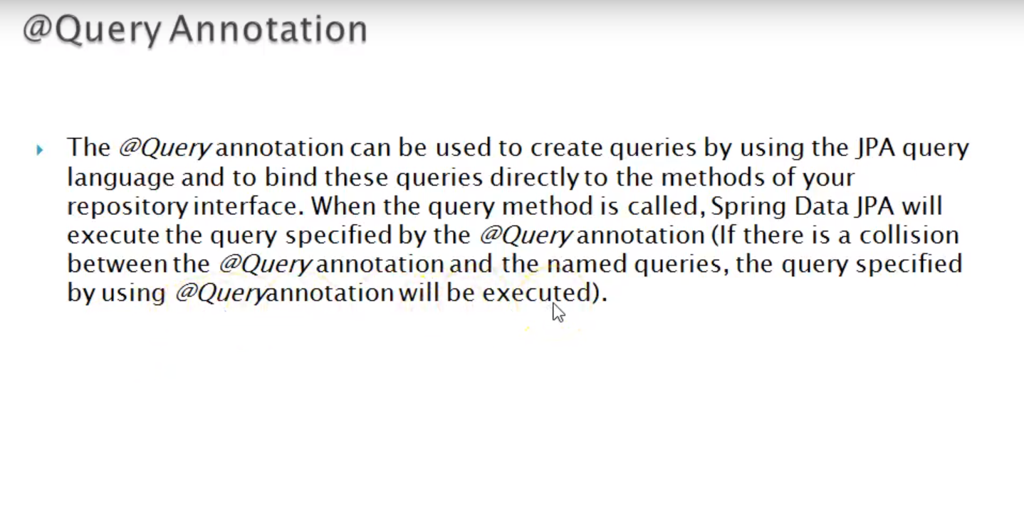
Spring JPA – Data Retrieval

Slide 6
Spring JPA – Data Retrieval

Slide 7
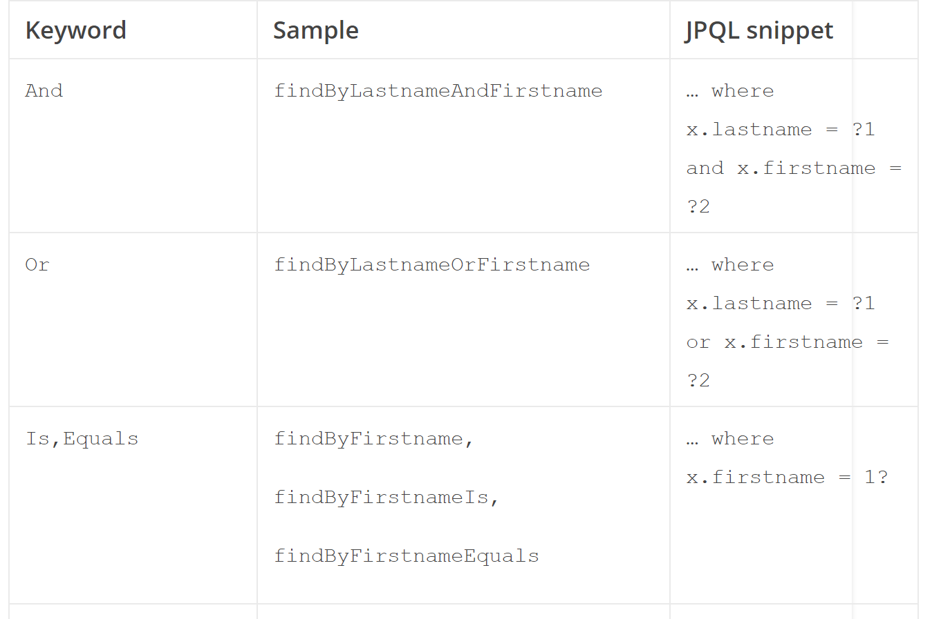
Spring JPA Example

Slide 8
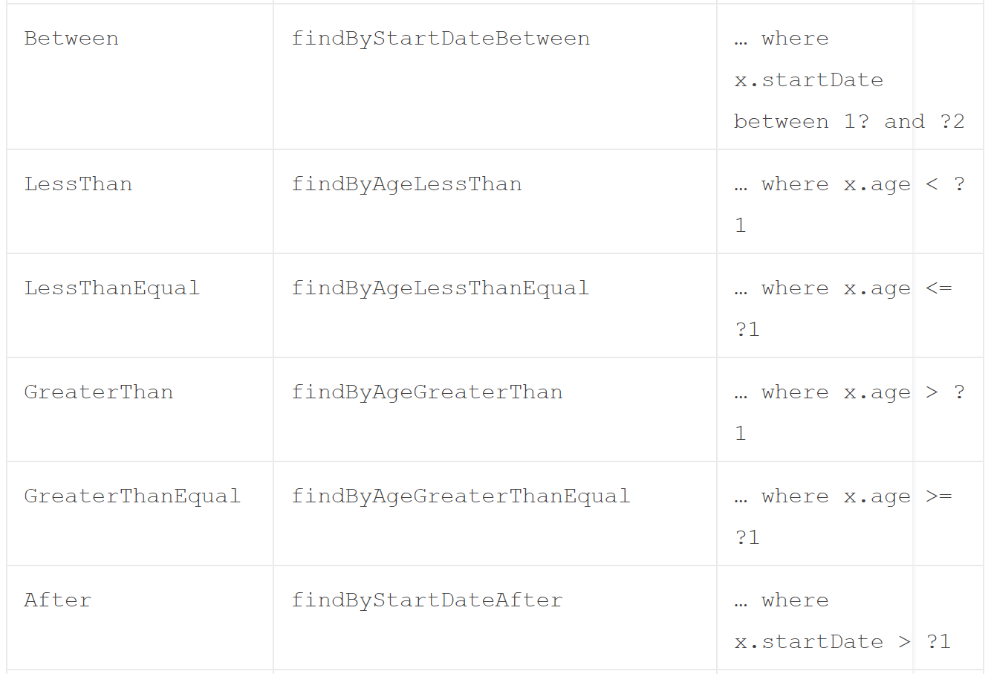
Spring JPA Example

Slide 9
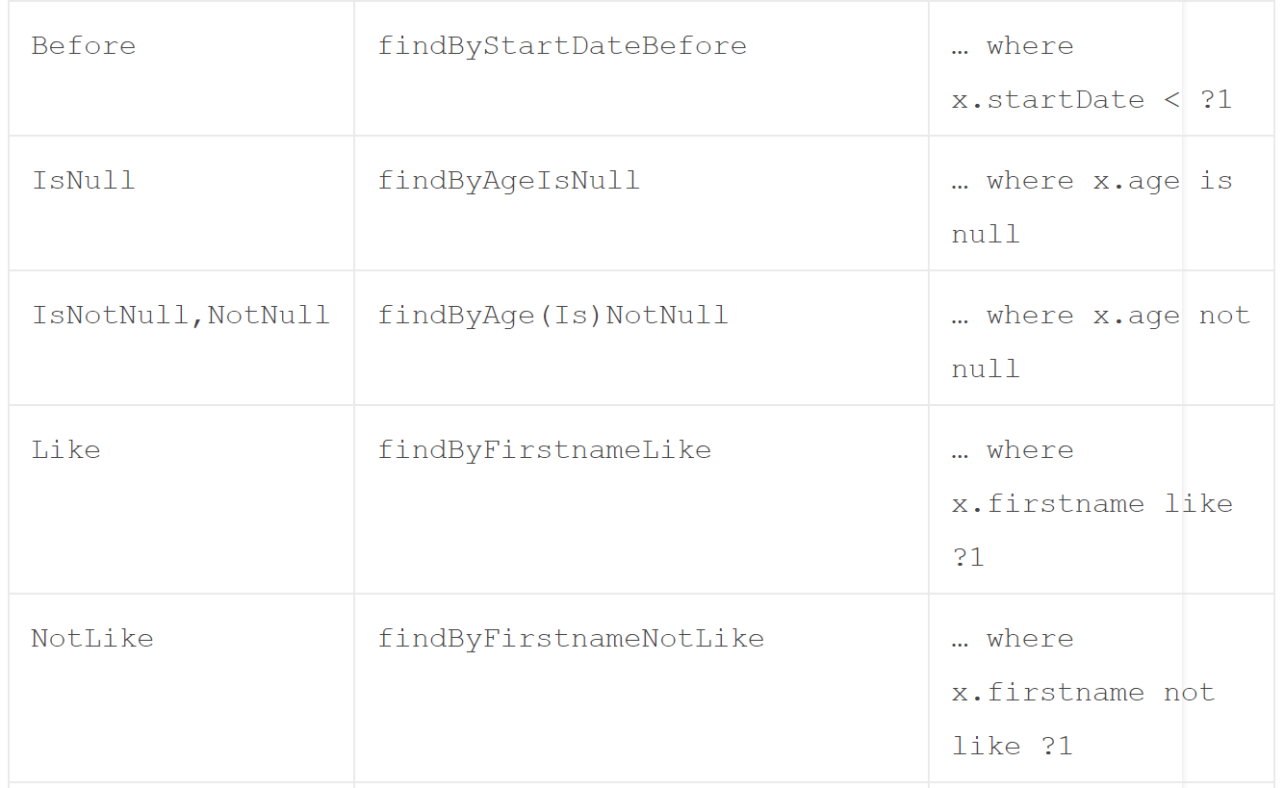
Spring JPA Example

Slide 10
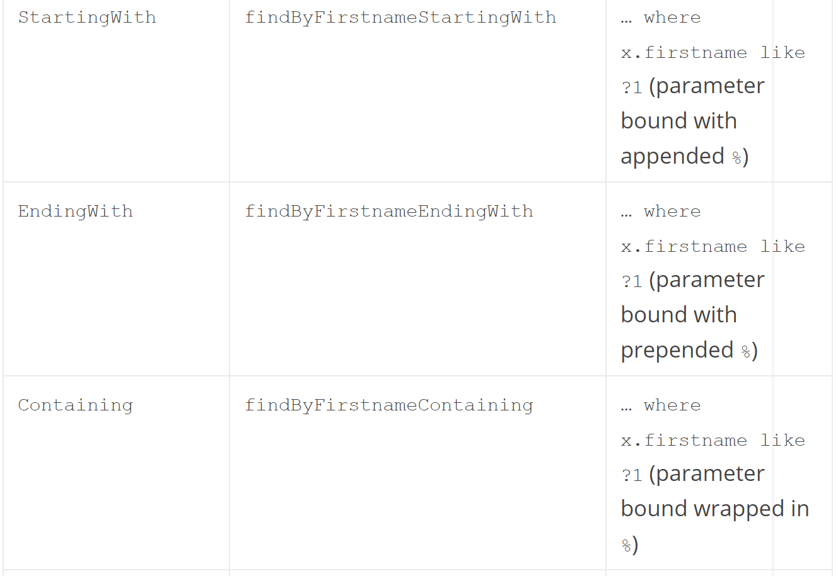
Spring JPA Example

Slide 11
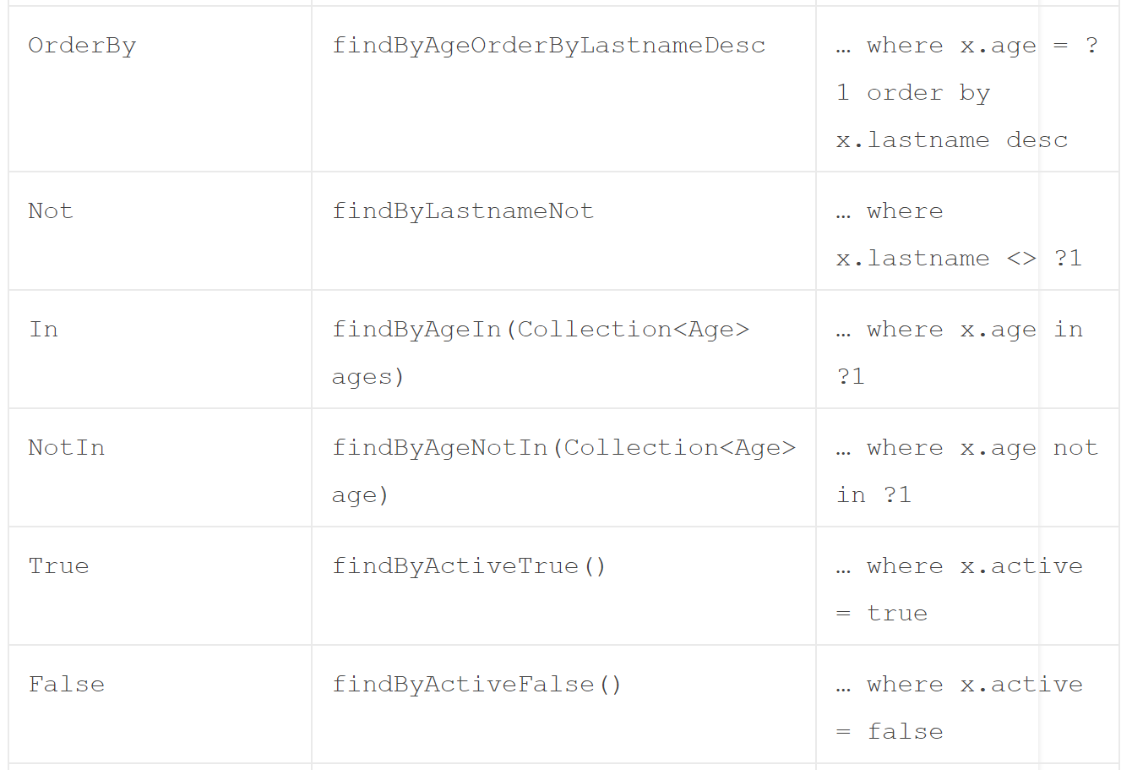
Spring JPA Example

Slide 12
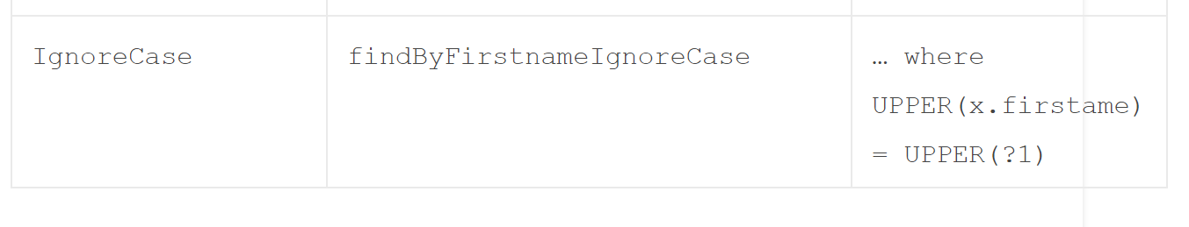
Spring JPA Example
https://docs.spring.io/spring-data/jpa/docs/current/reference/html/
Note: You can also use readBy, getBy, and queryBy in place of findBy and Spring Data JPA would behave the same. For example, readByName(String name) is equivalent to findByName(String name).

Slide 13
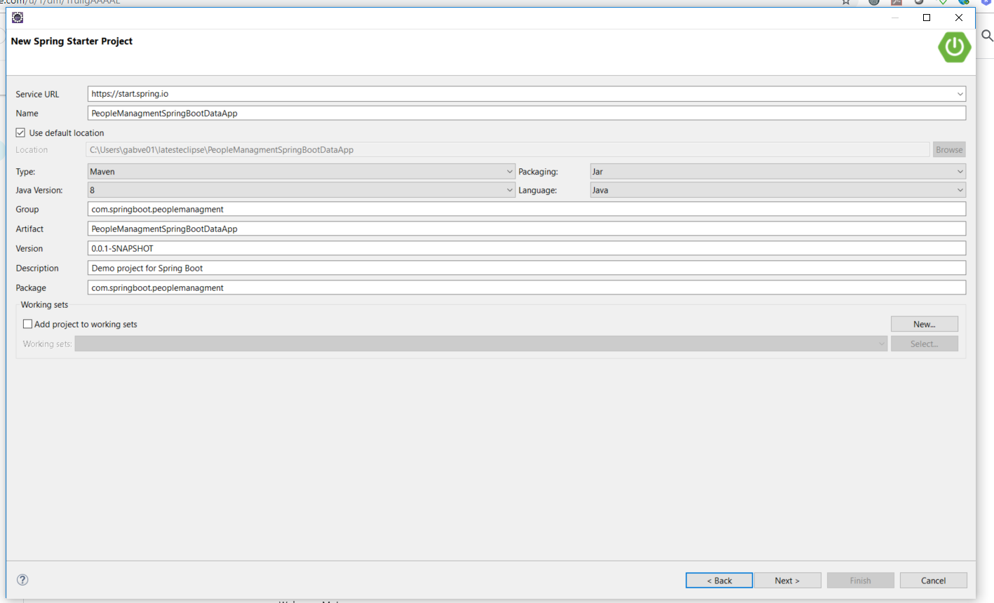
Spring JPA Example

Slide 14
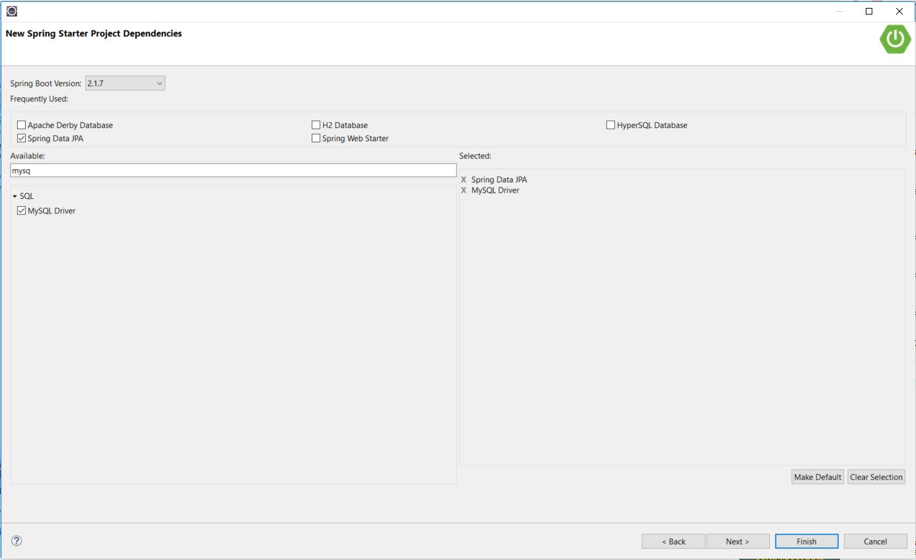
Spring JPA Example

Slide 15
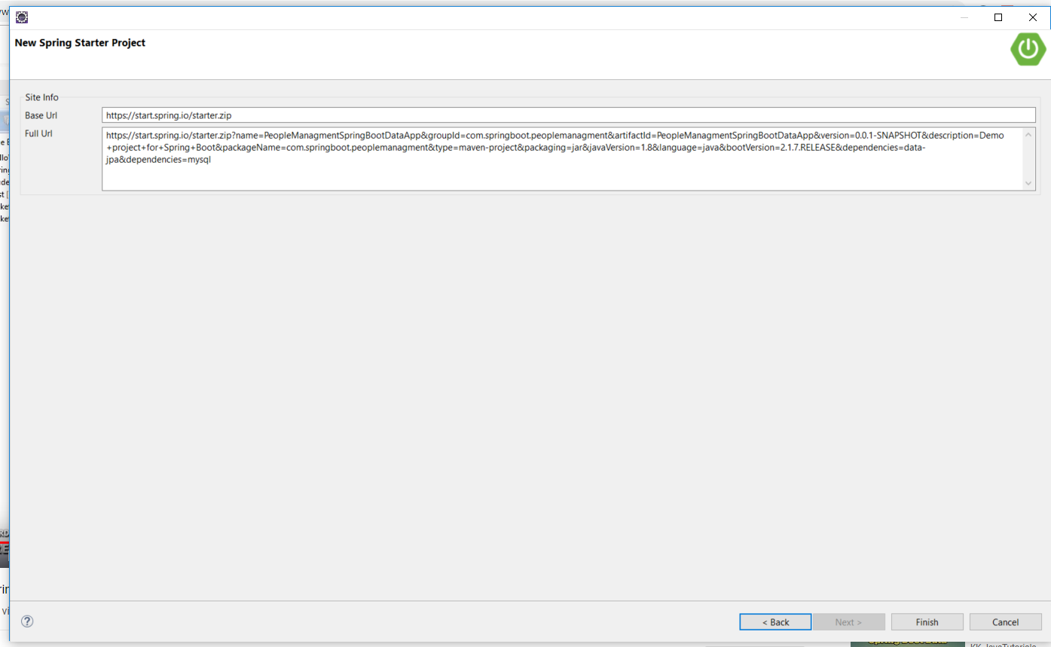
Spring JPA Example

Slide 16
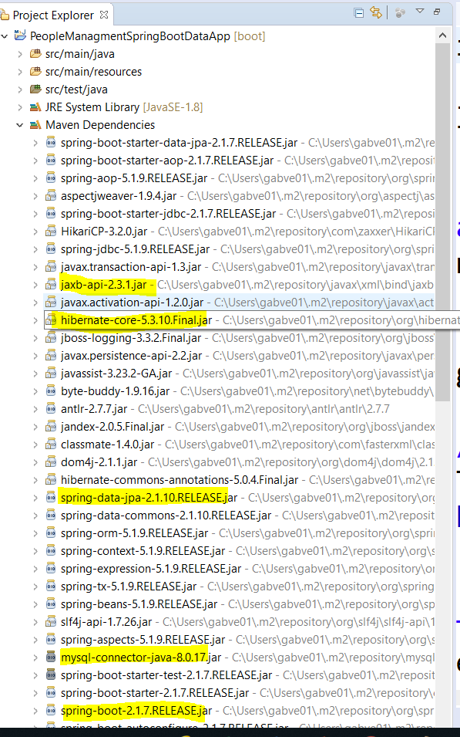
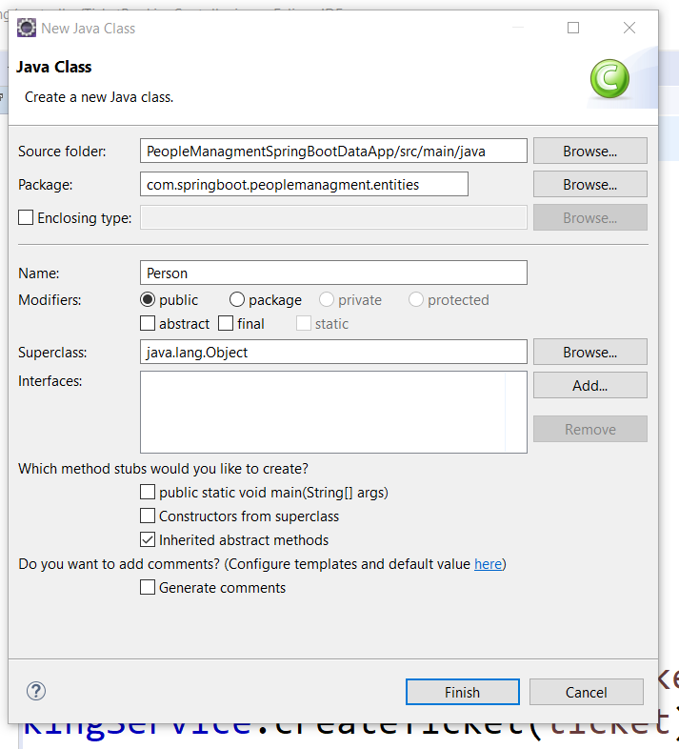

Slide 17
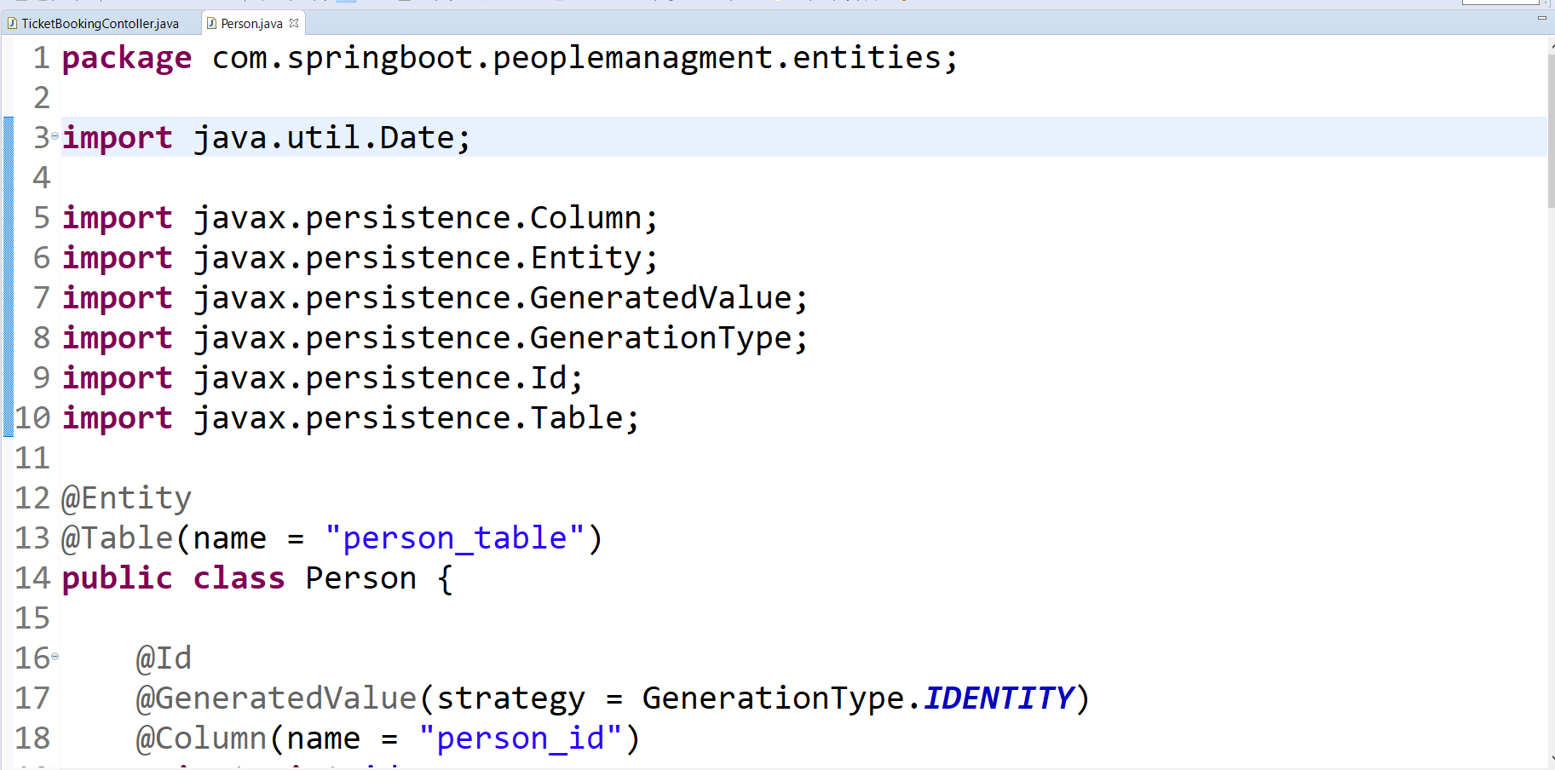
Spring JPA Example

Slide 18
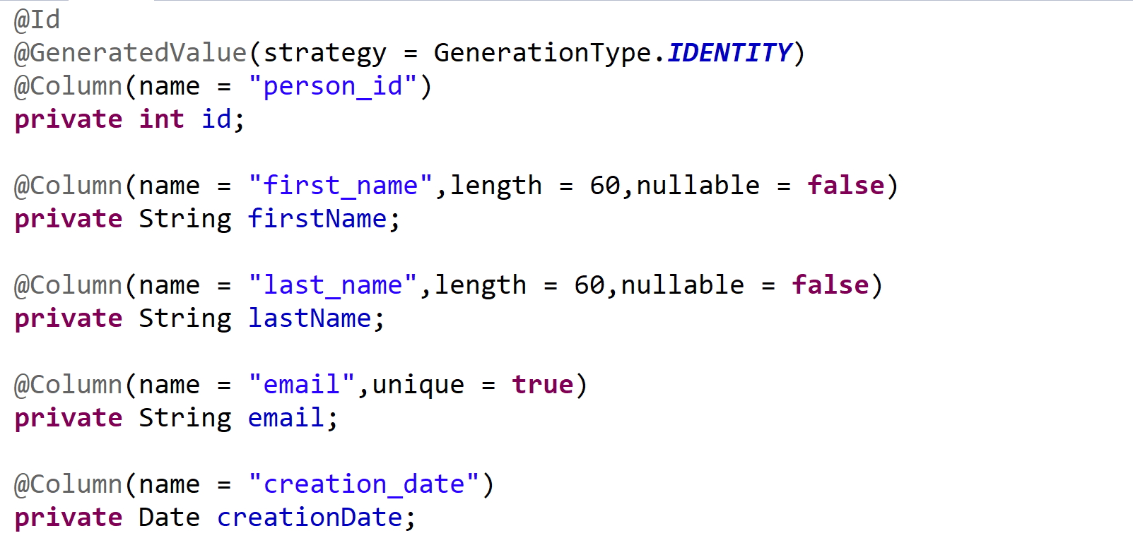
Spring JPA Example

Slide 19
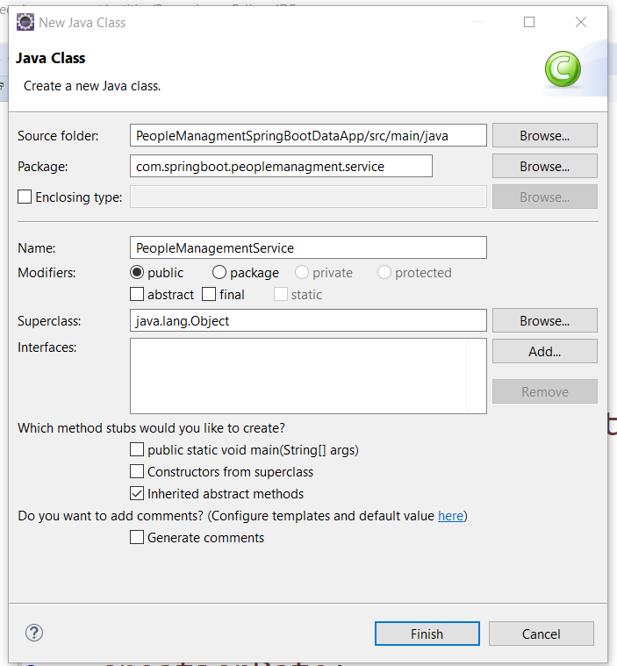
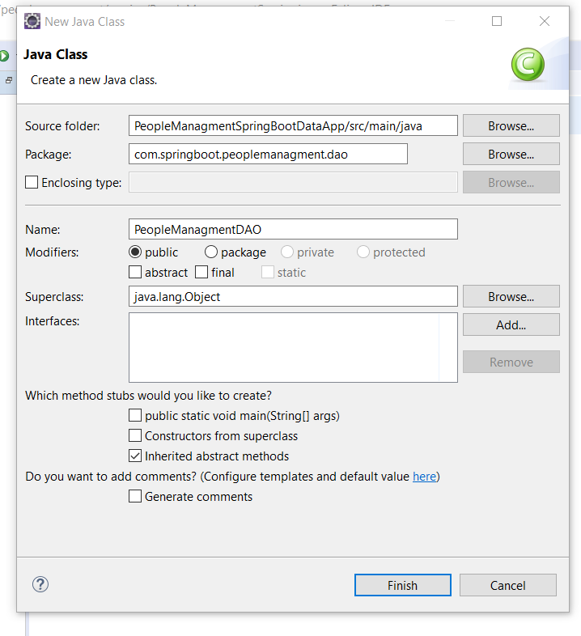
Spring JPA Example

Slide 20
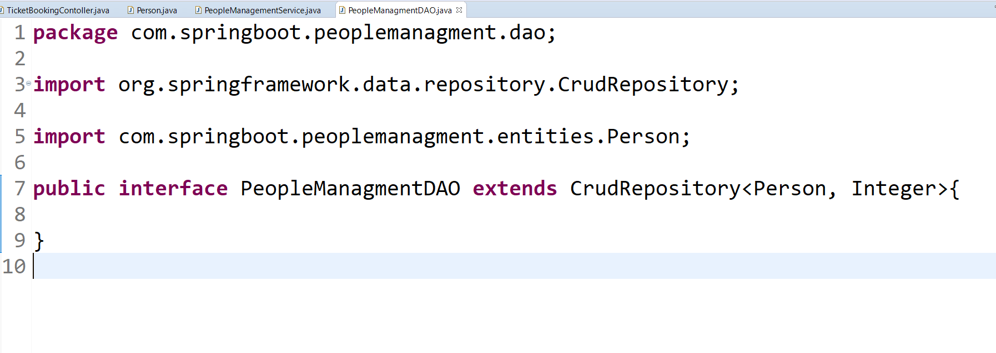
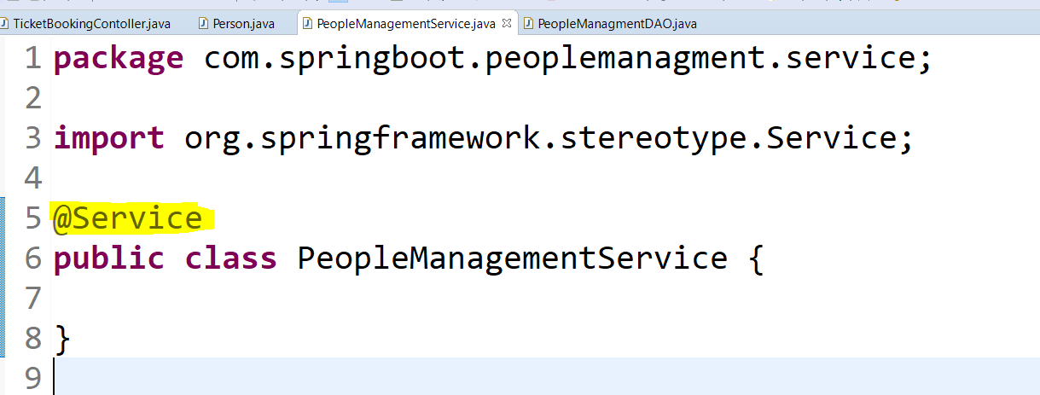
Spring JPA Example

Slide 21
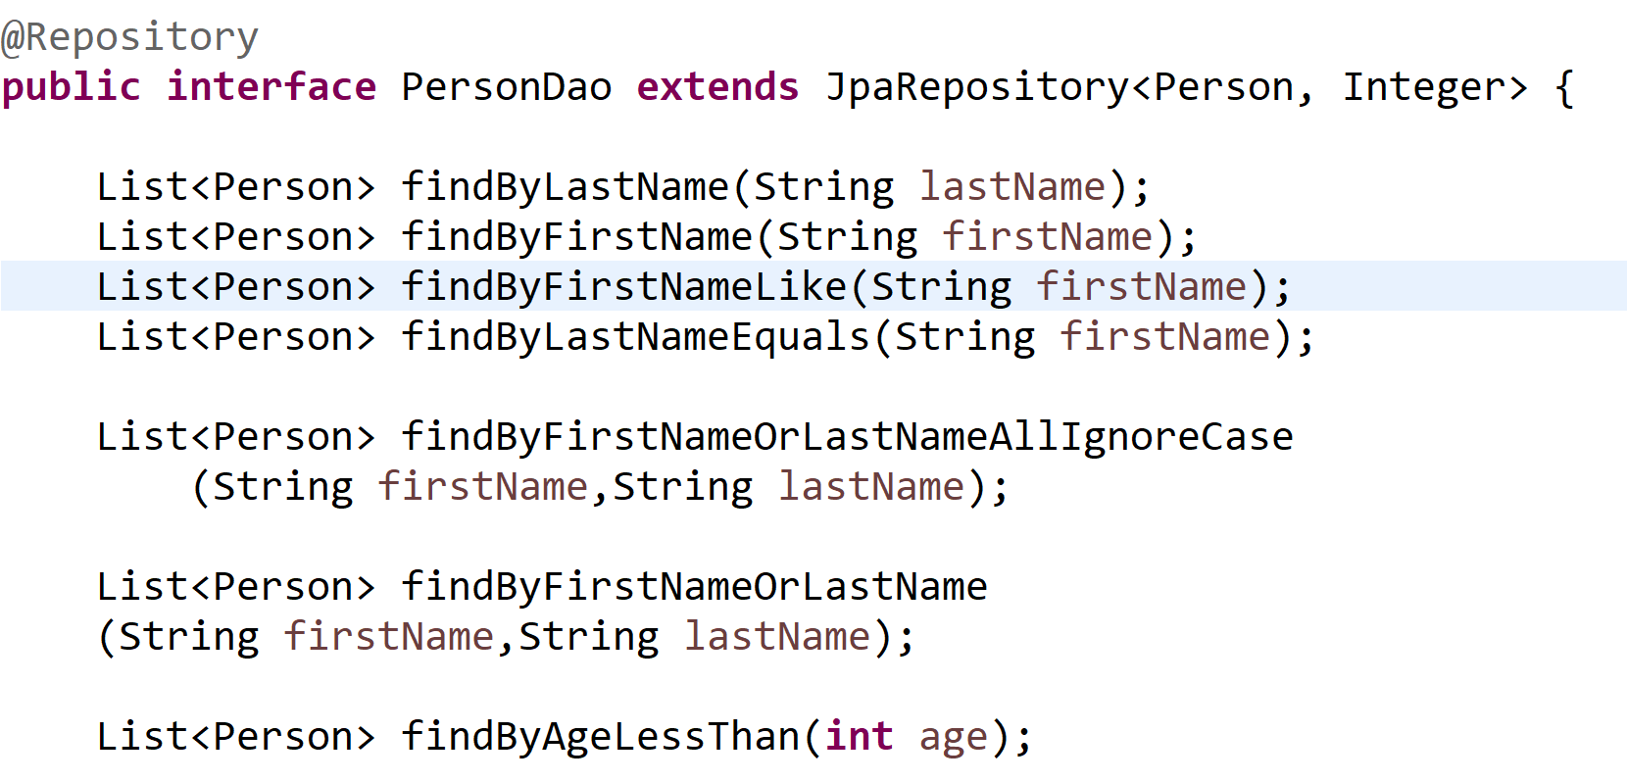
Spring JPA Example

Slide 22
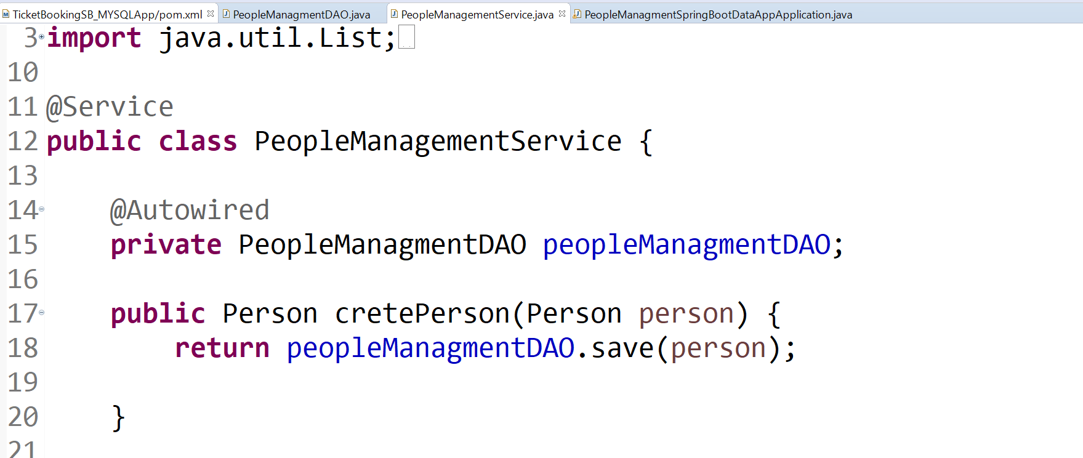
Spring JPA Example

Slide 23
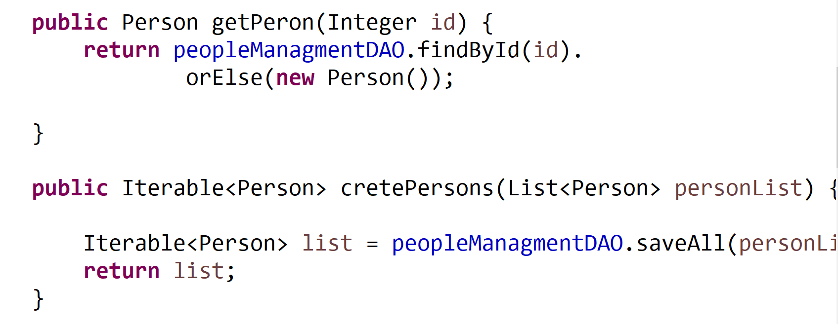
Spring JPA Example

Slide 24
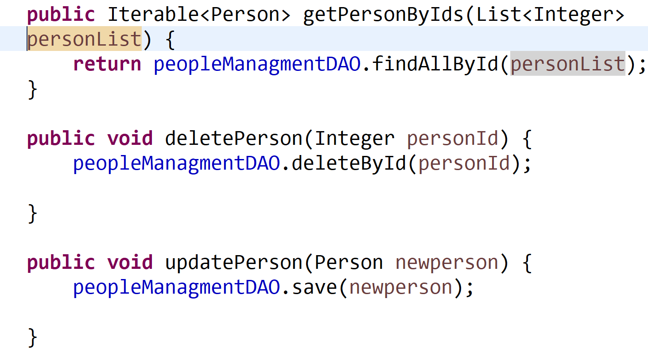
Spring JPA Example

Slide 25
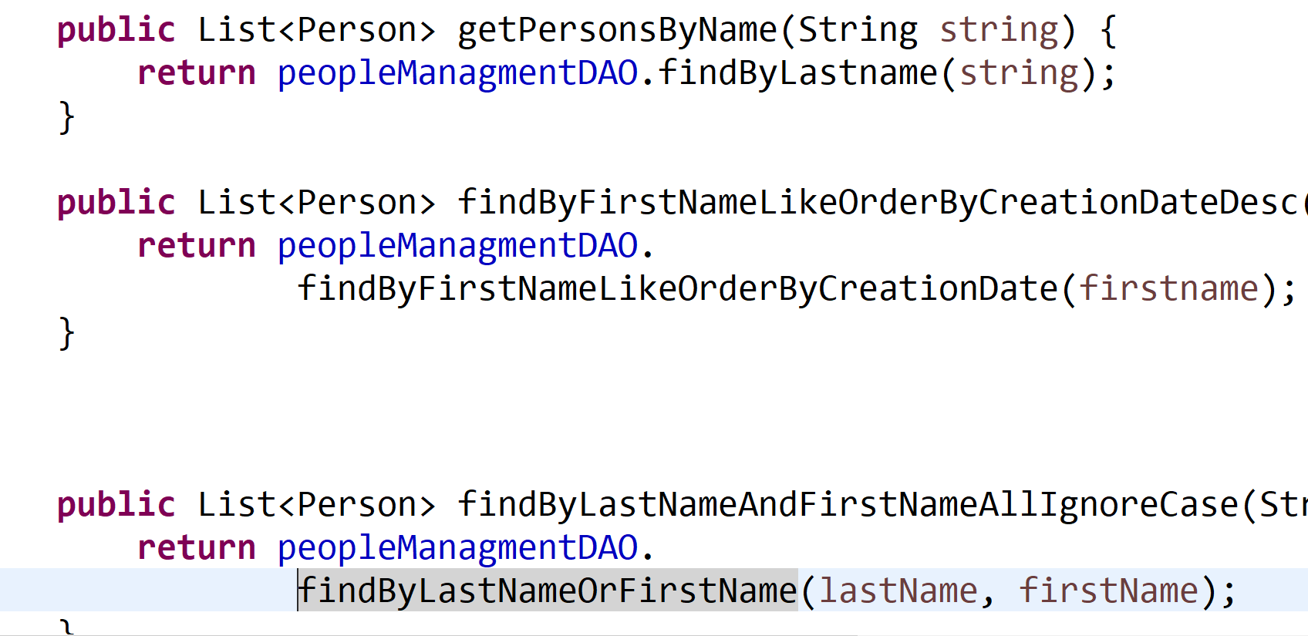
Spring JPA Example

Slide 26
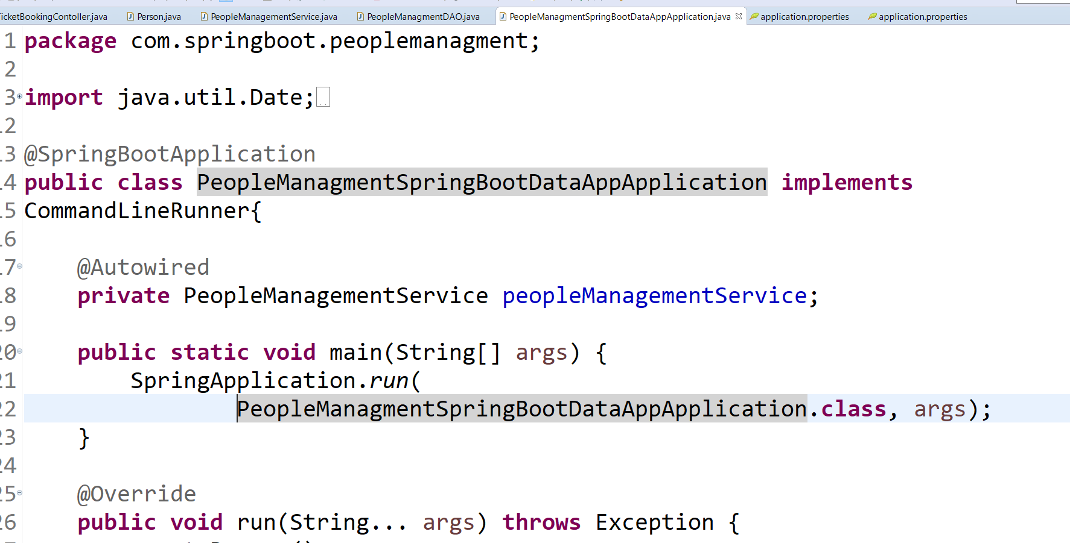
Spring JPA Example

Slide 27
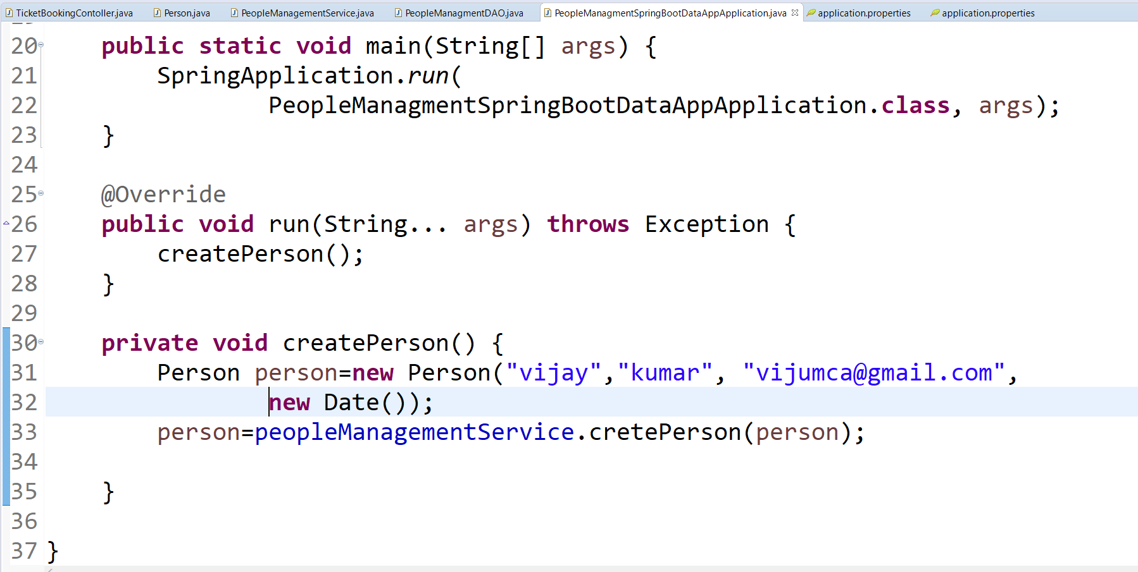
Spring JPA Example

Slide 28
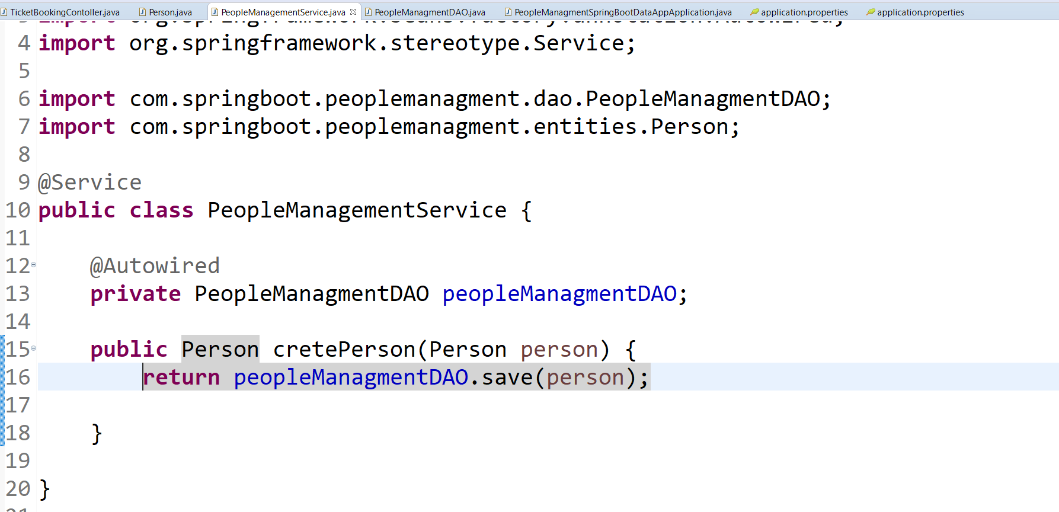
Spring JPA Example

Slide 29
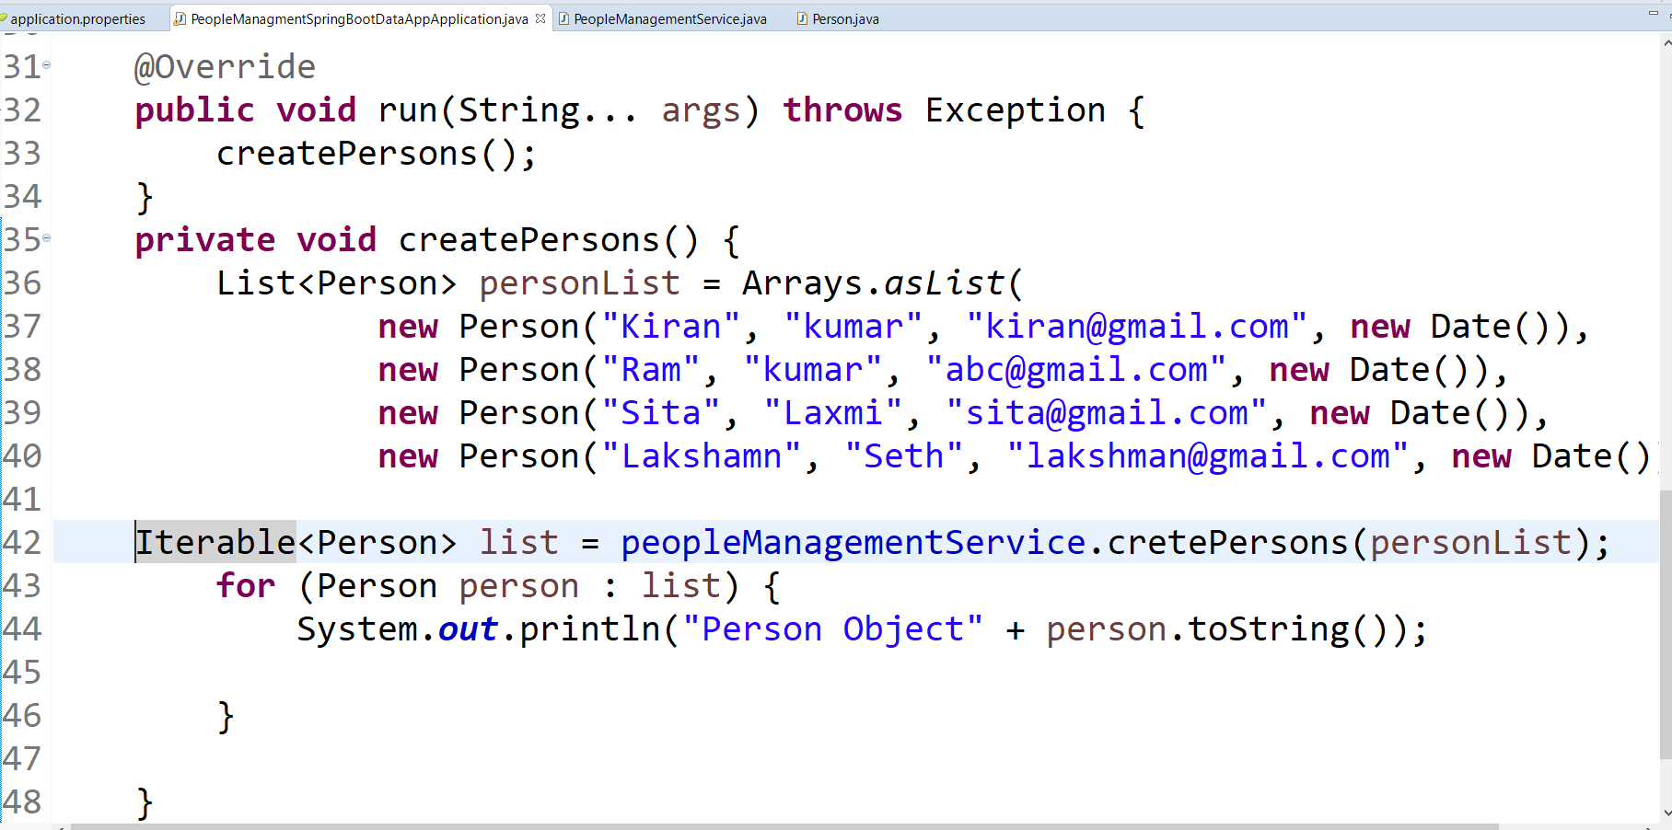
Spring JPA Example

Slide 30
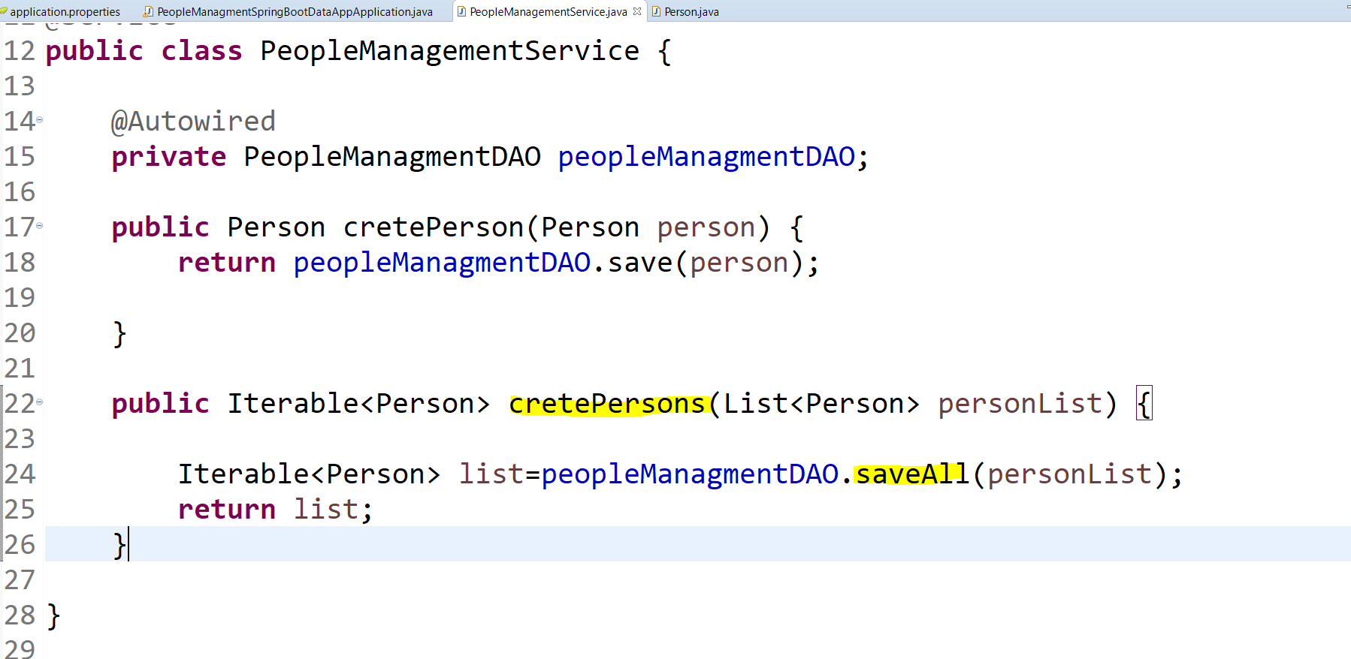
Spring JPA Example

Slide 31
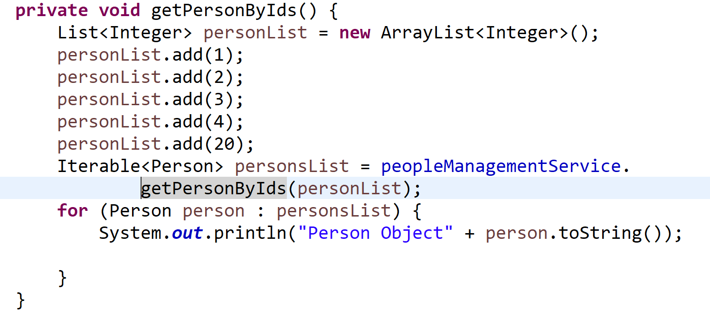
Spring JPA Example

Slide 32
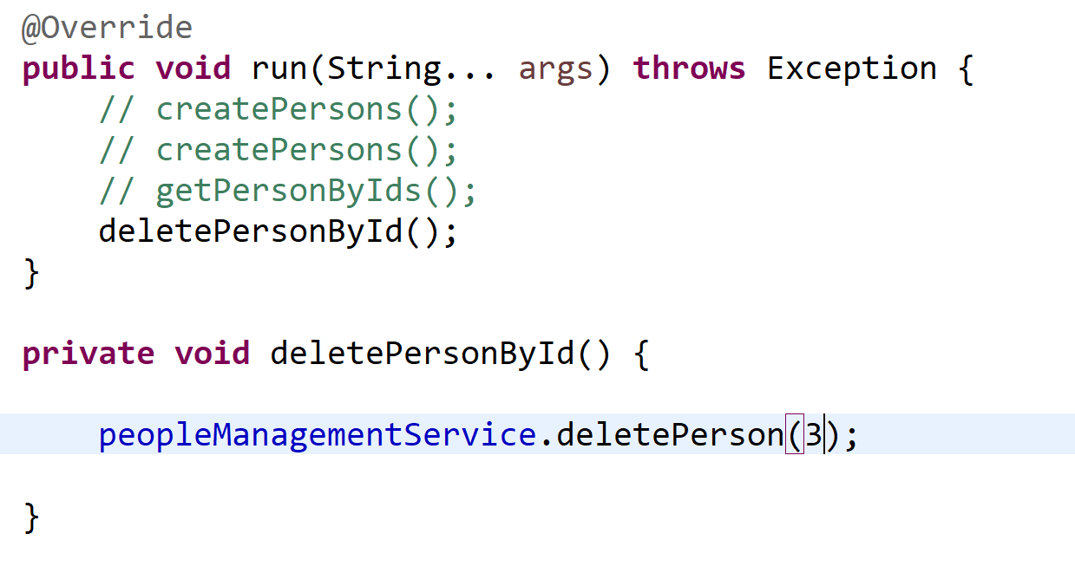
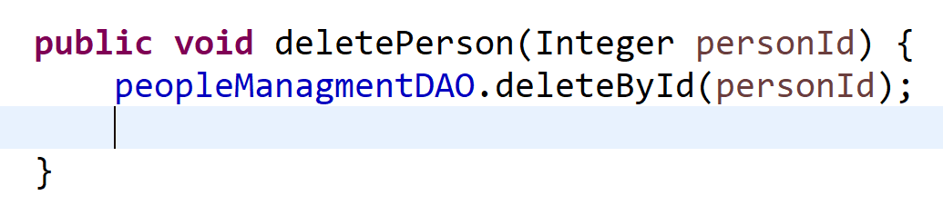
Spring JPA Example

Slide 33
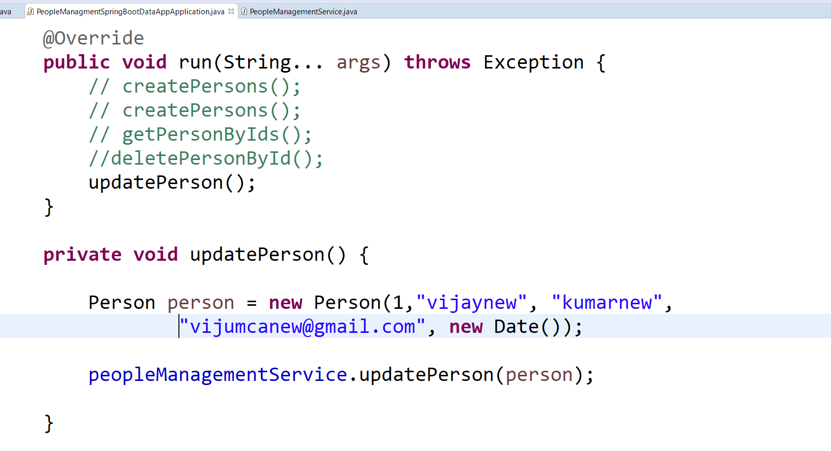
Spring JPA Example

Slide 34
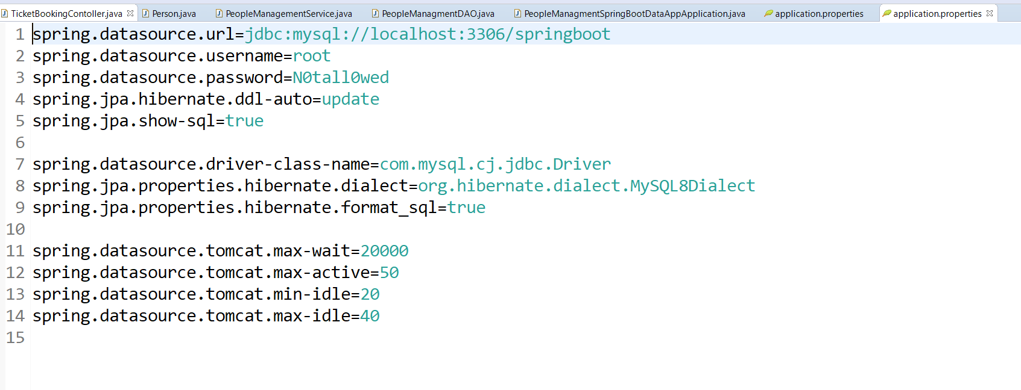
Spring JPA Example

Slide 35
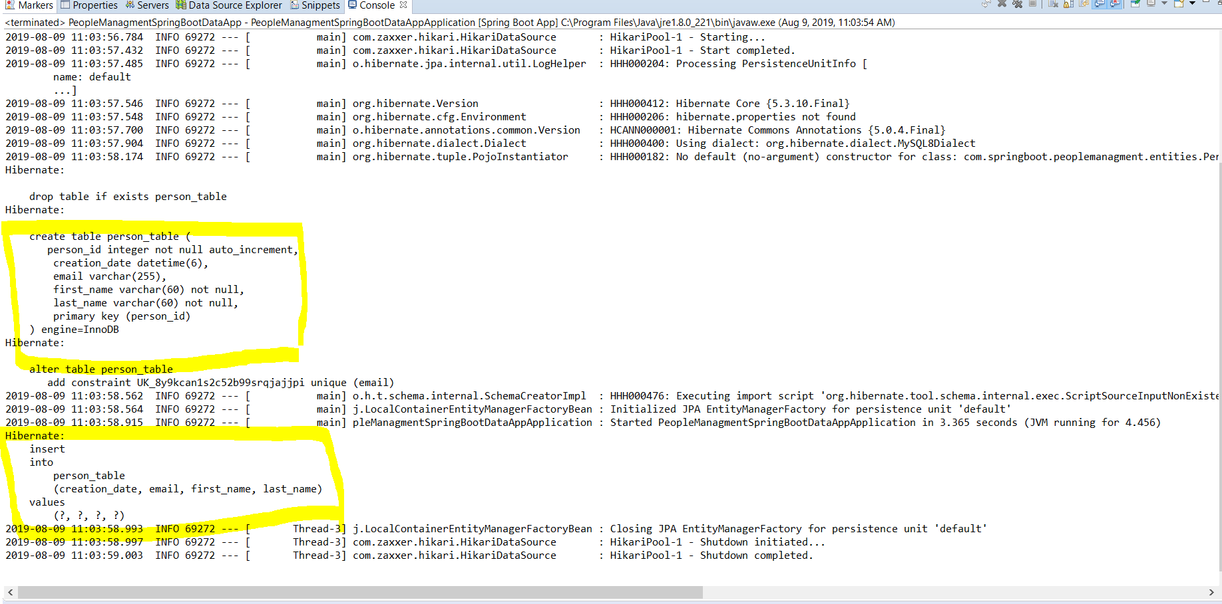
Spring JPA Example

Slide 36
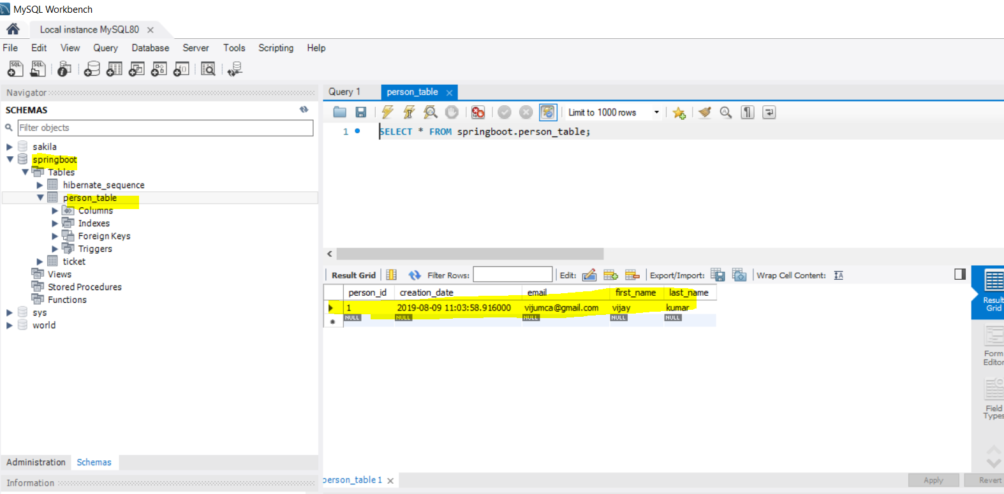
Spring JPA Example

Slide 37
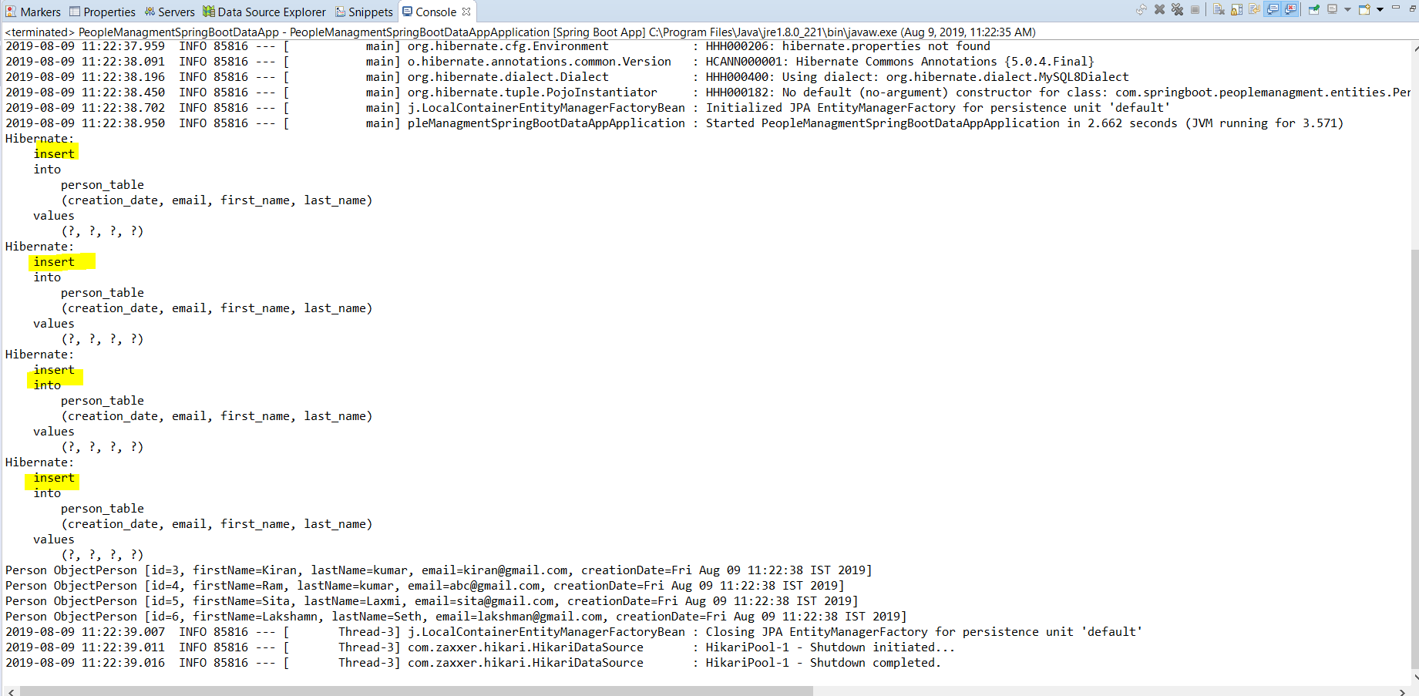
Spring JPA Example

Slide 38
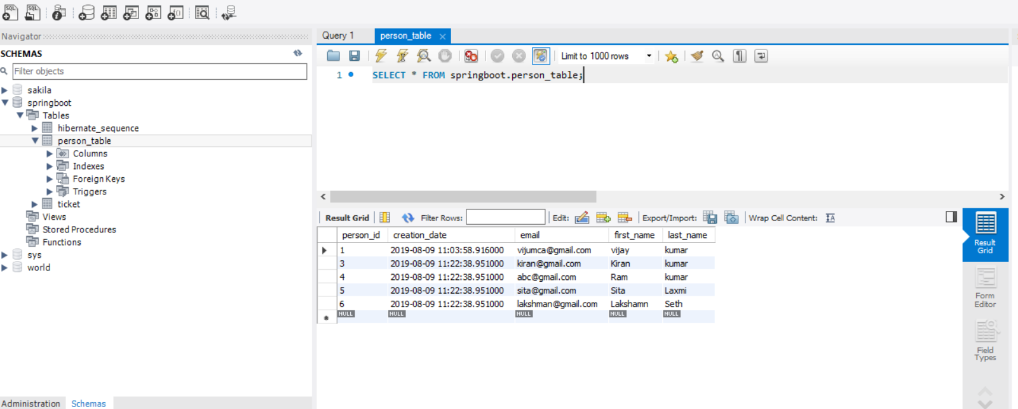
Spring JPA Example

Slide 39
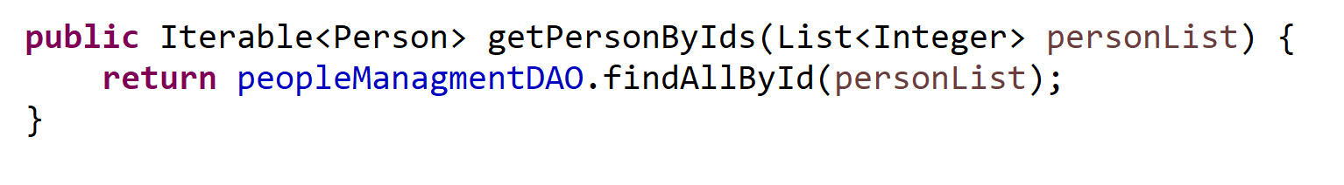
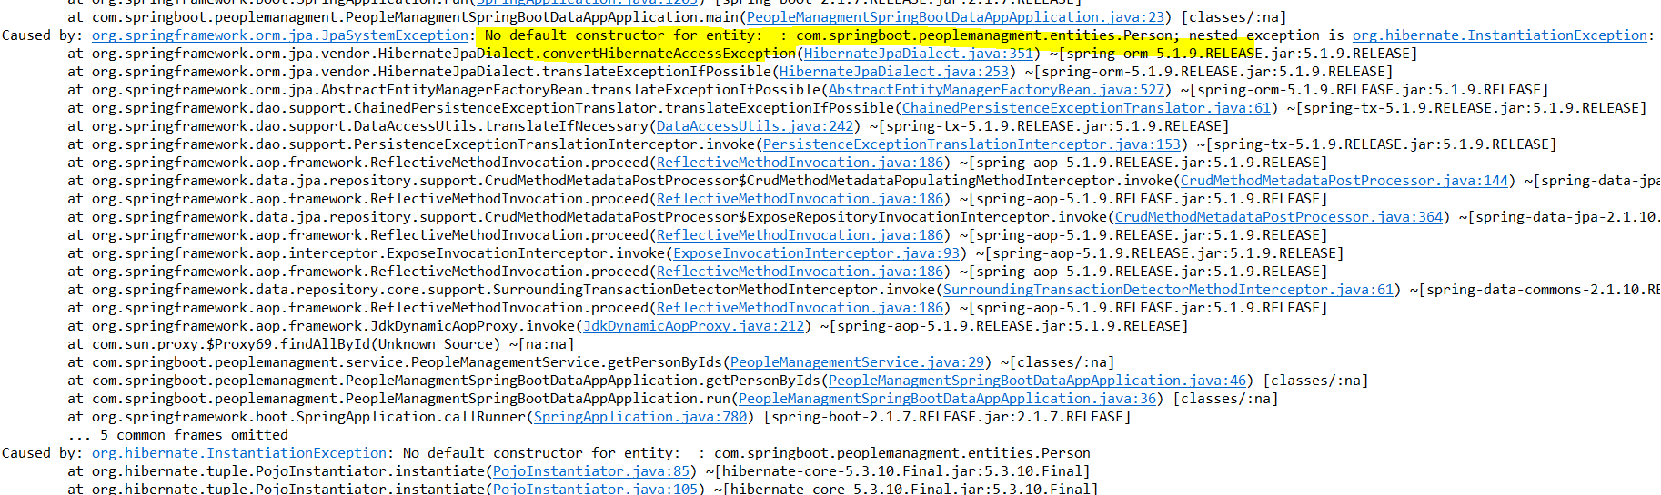
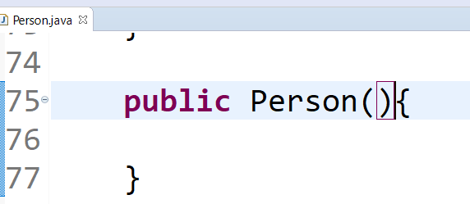
Spring JPA Example

Slide 40
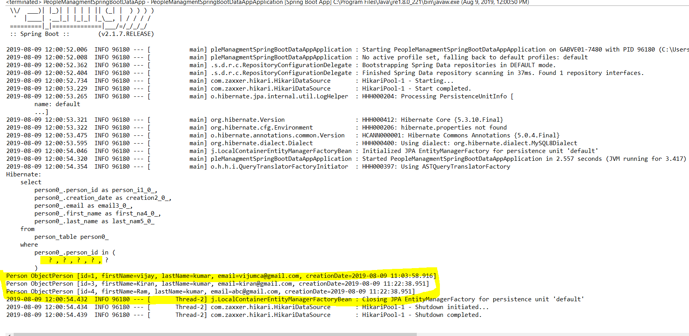
Spring JPA Example

Slide 41
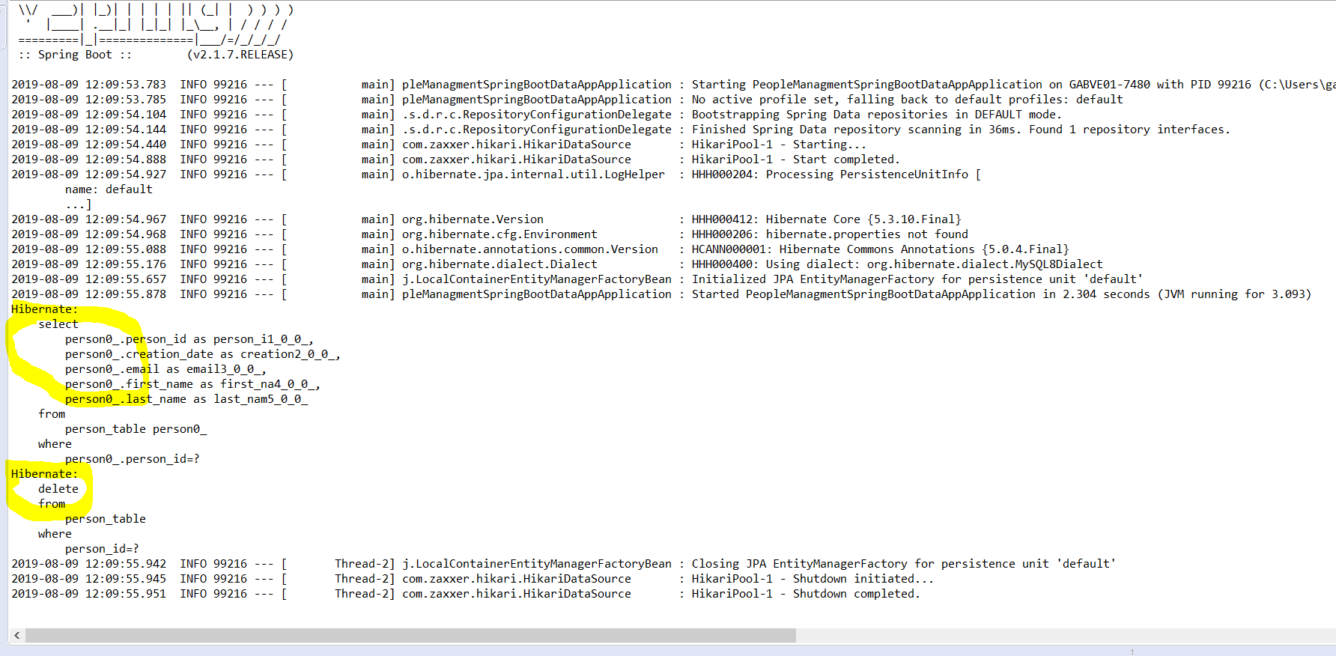
Spring JPA Example

Slide 42
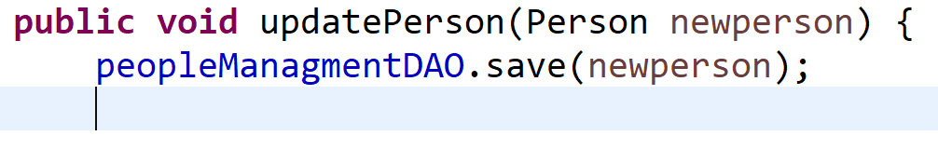
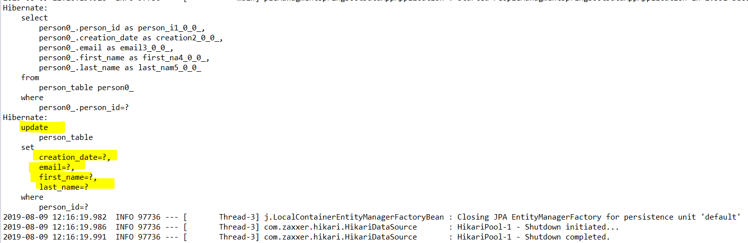
Spring JPA Example

Slide 43
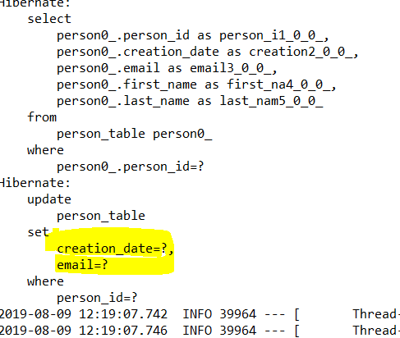
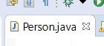


Spring JPA Example

Slide 44


Spring JPA Example

Slide 45



Spring JPA Example

Slide 46




Spring JPA Example

Slide 47
Spring JPA Example

Slide 48


Spring JPA Example- NamedQuery

Slide 49


Spring JPA Example

Slide 50


Spring JPA Example

Slide 51

Spring JPA Example

Slide 52


Spring JPA Example

Slide 53


Spring JPA Example

Slide 54

Spring JPA Example – Many to Many Relation

Slide 55

Spring JPA Example – Many to Many Relation

Slide 56


Spring JPA Example

Slide 57


Spring JPA Example

Slide 58


Spring JPA Example

Slide 59


Spring JPA Example

Slide 60

Spring JPA Example

Slide 61

Spring JPA Example

Slide 62

Spring JPA Example

Slide 63

Spring JPA Example

Slide 64

Spring JPA Example- Named Native Query

Slide 65

Spring JPA Example- Named Native Query

Slide 66


Spring JPA Example- Named Native Query

Slide 67


Spring JPA Example- Named Native Query

Slide 68

Spring JPA Example- Query

Slide 69


Spring JPA Example- Query

Slide 70


Spring JPA Example- Query

Slide 71

Spring JPA Example-QUERY Annotation

Slide 72

Spring JPA Example- Query

Slide 73


Spring JPA Example- Native SQL Query

Slide 74


Spring JPA Example- Native SQL Query

Slide 75

Special Parameter Handling – Pagination & Sorting
A Page knows about the total number of elements and pages available. It does so by the infrastructure triggering a count query to calculate the overall number. As this might be expensive depending on the store used, Slice can be used as return instead. A Slice only knows about whether there’s a next Slice available which might be just sufficient when walking through a larger result set

Slide 76

JPA Repository vs CRUD Repository
CrudRepository mainly provides CRUD functions.
PagingAndSortingRepository provides methods to do pagination and sorting records.
JpaRepository provides some JPA-related methods such as flushing the persistence context and deleting records in a batch.
Because of the inheritance mentioned above, JpaRepository will have all the functions of CrudRepository and PagingAndSortingRepository.
So if you don't need the repository to have the functions provided by JpaRepository and PagingAndSortingRepository , use CrudRepository

Slide 77

Special Parameter Handling – Pagination & Sorting

Slide 78

Special Parameter Handling – Pagination & Sorting

Slide 79




Special Parameter Handling – Pagination & Sorting

Slide 80

Special Parameter Handling – Pagination & Sorting

Slide 81

Special Parameter Handling – Pagination & Sorting

Slide 82




Special Parameter Handling – Pagination & Sorting

Slide 83

Special Parameter Handling – Pagination & Sorting

Slide 84

ASYNC QUERY RESULTS

Slide 85

ASYNC QUERY RESULTS

Slide 86



ASYNC QUERY RESULTS

Slide 87


ASYNC QUERY RESULTS

Slide 88

ASYNC QUERY RESULTS

Slide 89

ASYNC QUERY RESULTS

Slide 90

ASYNC QUERY RESULTS

Slide 91



ASYNC QUERY RESULTS- Custom Configuration

Slide 92
Asynch Results
Pagination

